Slide 1
INTRODUCTION TO R/RSTUDIO
JOSE DE VEGA
jose.devega@earlham.ac.uk

Slide 2
Please ensure you have the latest version of R and RStudio installed on your machine. Check https://www.rstudio.com/
Start a new file, such as a R script, an editor panel will open in the top left.
Start writing in an .R file and use RStudio’s command / short cut to push current line, selected lines or modified lines to the interactive R console.
The interactive R console (entire left)
Environment/History (tabbed in upper right)
Files/Plots/Packages/Help/Viewer (tabbed in lower right)
An excellent tutorial: http://swcarpentry.github.io/r-novice-gapminder/

Slide 3
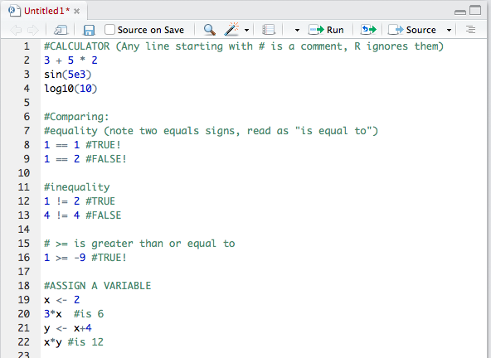
Your first tasks in R (Copy and run this commands): Use R as a calculator Compare things Assign variables and use them Always use <- to assign values to variables Eg.) daysAfterGerm <- 13

Slide 4
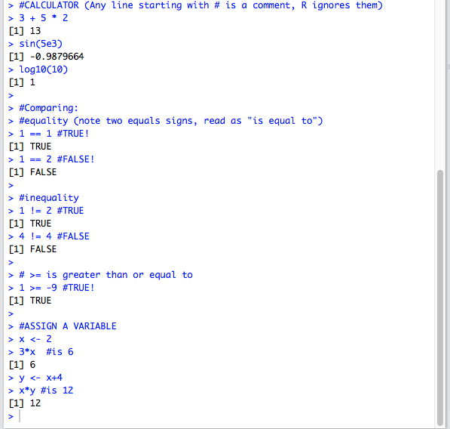
Your first tasks in R (Copy and run this commands): Use R as a calculator Compare things Assign variables and use them Always use <- to assign values to variables Eg.) daysAfterGerm <- 13

Slide 5
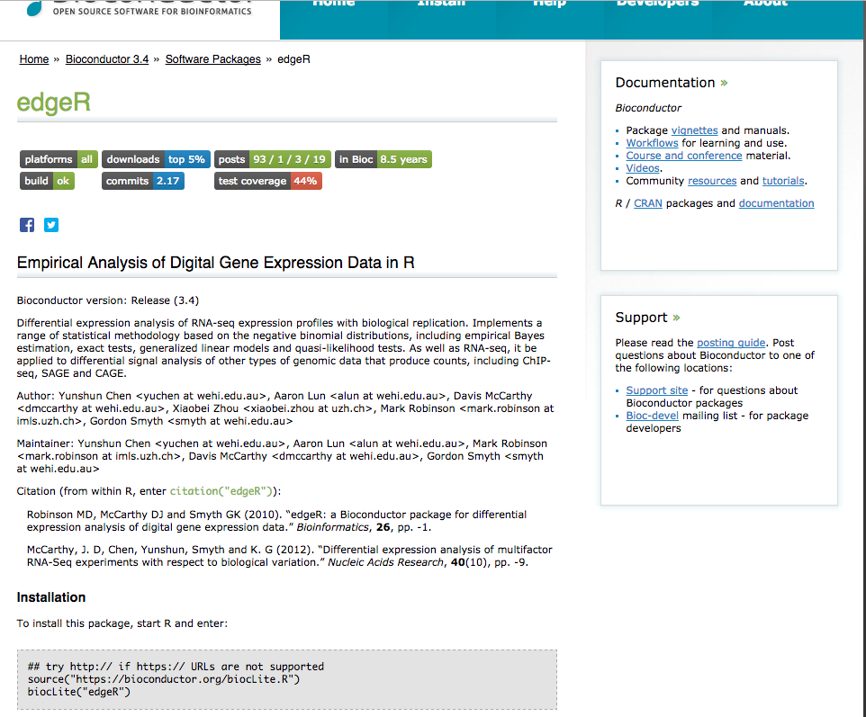
R packages (or libraries)
1) Install the following packages: ggplot2, plyr, gapminder
You can use the graphic interface
or the command install.packages(”name"), eg. install.packages("plyr")
2) Choose a package from https://www.bioconductor.org/
And install it.
TRICK: Look for the instructions in the package webpage…

Slide 6
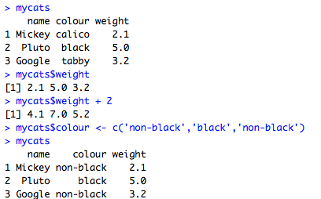
Your first “real” tasks in R: Starting with data
Create a new text file with some comma-separated data and save it in your Desktop:
Menu: File > New file > Text file
name,colour,weight
Mickey,calico,2.1
Pluto,black,5
Google,tabby,3.2
Import it into R and see it:
mycats <- read.csv(file = ”~/Desktopcats.csv")
mycats
Pull out columns by specifying them using the $ operator:
mycats$weight
Change all the colour column to “black or not” and see it:
mycats$colour <- c(‘non-black’,’black’,’non-black’)
mycats
By a calibration error, all the weights are 2 Kg short, can you correct them?
mycats$weight + 2
mycats
Q: It hasn’t been save, why? How do you permanently modify the original data?

Slide 7

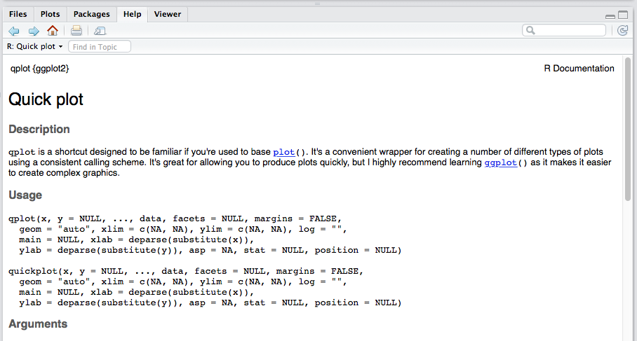
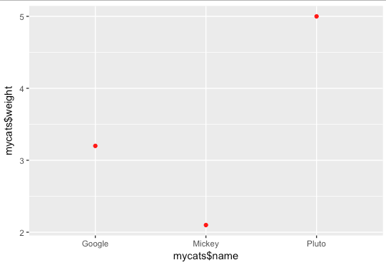
Plot some data…
Load the library “ggplot2”, try to plot the previous data in a scatterplot
Try to increase the size and change the colour of the dots

